Slide 1
Friction Loss & Pump Discharge Pressure
Calculations

Slide 2
Friction Loss
FL= C (Q)²(L)
FL= C (Q/100)² (L/100)
FL- Friction Loss
C- Coeficient (Pre-set Values)
Q- Quanity (GPM)
L- Length (Length of Hose)
Per 100’ of hose | Coefficient
1” | 150
1 ½” | 24
1 ¾” | 15.5
2 ½” | 2
3” | 0.8
4” | 0.2
5” | 0.08

Slide 3
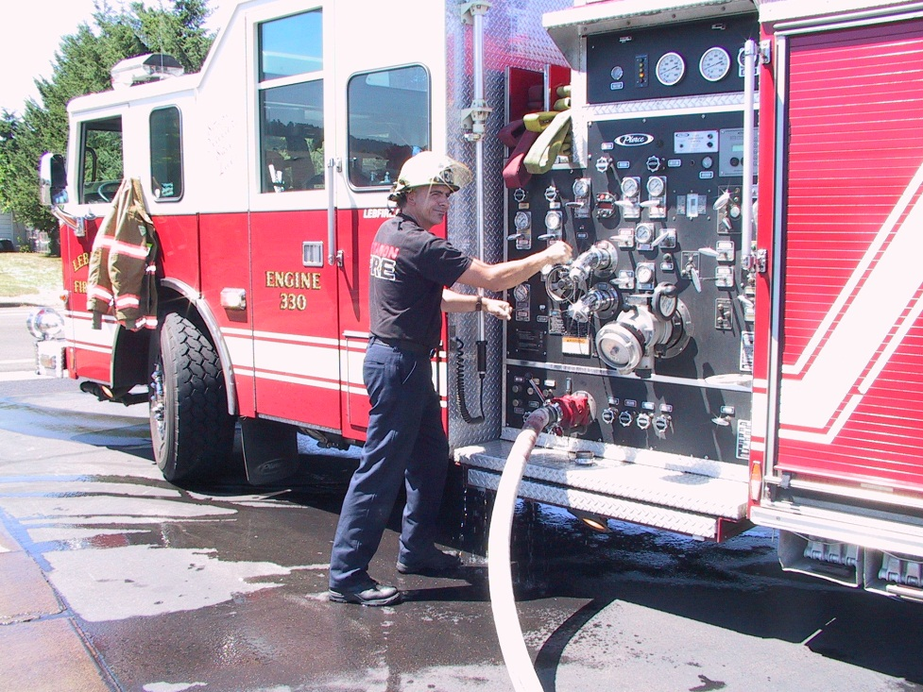
Friction Loss Example
You have 200’ of 1 ¾ “ hose flowing 150GPM. What is your friction loss?
FL = C (Q/100)² (L/100)
FL = 15.5 (150/100)² (200/100)
FL = 15.5 (1.5)² (2)
FL = 15.5 (2.25) (2)
FL= 69.75 (round up to 70)
P1

Slide 4
Figuring Friction Loss
Scenario :
Your officer orders the front pre-connected
1 ¾“ line (150’) to extinguish a 9 car blaze.
You will have 200GPM at the nozzle. What is your friction loss?
200 GPM
150’ of hose
P2

Slide 5
Pump Discharge Pressure
PDP = FL + NP +/- Elevation
FL – Friction Loss
NP- Nozzle Pressure
Elevation – 5psi per 10ft elevation

Slide 6
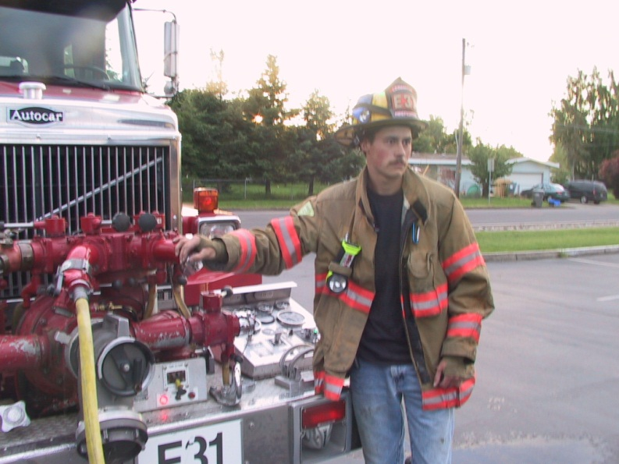
Pump Discharge Pressure Example
Nozzle pressure TFT metro 1 Nozzle = 50 PSI
Friction Loss from previous calculation = 70 PSI
Elevation Loss/Gain = 0
PDP = NP + FL + Elevation
PDP = 50 + 70 + 0
PDP= 120

Slide 7
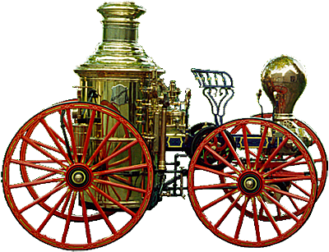
FL and PDP
You have a 200’ 1 ¾” line providing 95GPM. What is your friction loss?
On your line you have a TFT automatic Nozzle and have 20 feet of elevation. What is your PDP?
P3

Slide 8
Multiple Lines
Pump to the highest pressure and gate back other lines requiring lower pressure
P4

Slide 9
Supplying Multiple Lines
A pumper is suppyling multiple hand lines of varying lengths and sizes.
The first is 150’ of 1 ¾” hose flowing 150GPM with a TFT automatic nozzle.
The Second is 200’ of 2 ½” hose flowing 250 GPM with a smooth bore nozzle.
P4,

Slide 10
Elevation
5 PSI is added or taken away with every 10’ gain or loss of
Elevation.
1’
.434 x 10
= 4.34 PSI
.434 PSI
5 PSI

Slide 11
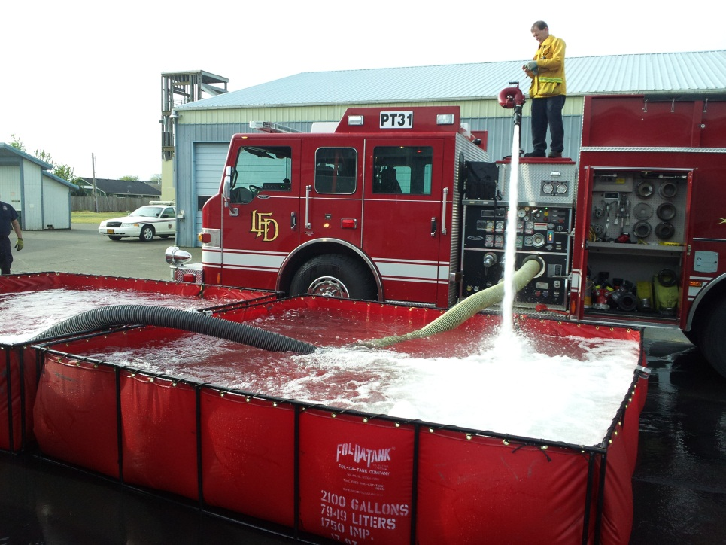
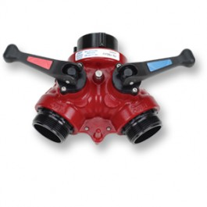
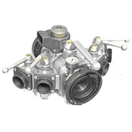
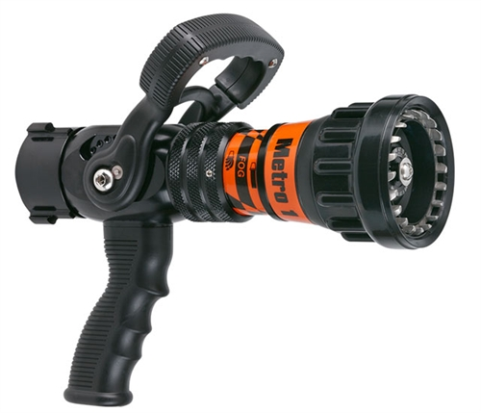
When flowing over 350GPM add 10PSI for
For the following appliances.
Gated Wye
Elevated Master Stream
Add 25PSI
80 PSI at the tip
Clappered Siamese
Manifold
Metro 1
50 PSI

Slide 12
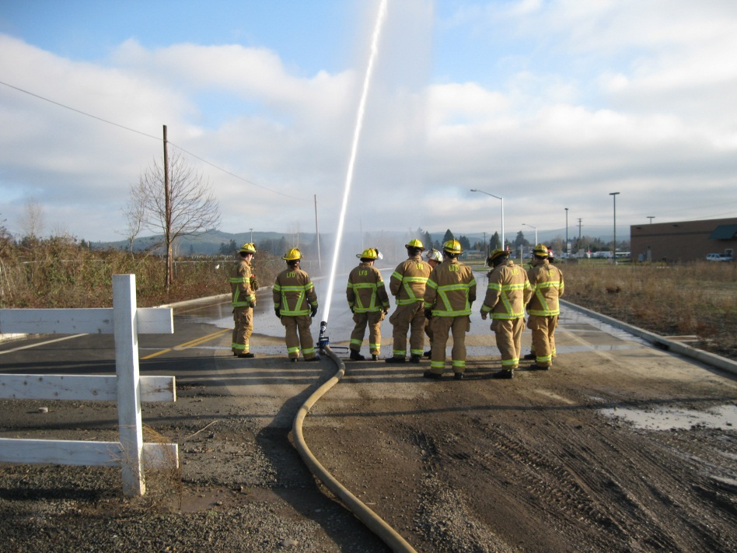
Blitz Fire
Smooth bore 1 ½” provides 600 GPM
Pump at 135 PSI
Fog Nozzle provides 500 GPM
Pump at 135 PSI

Slide 13
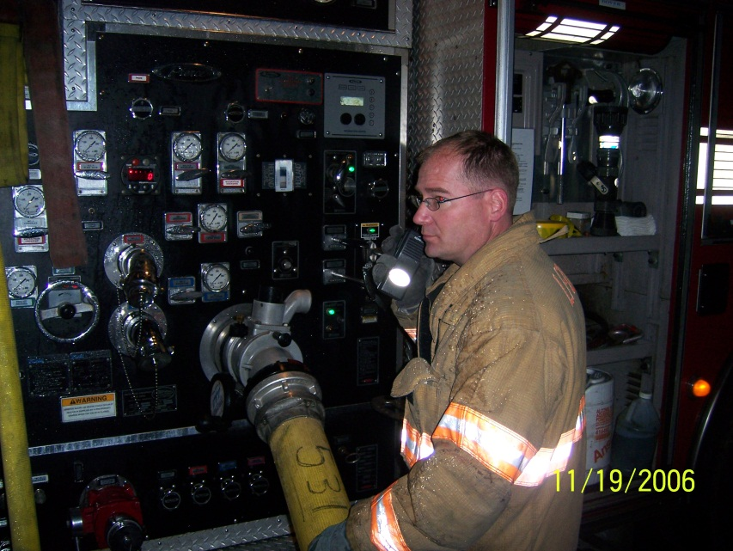
FL for Wyed Hose Lines
Start By adding the flow rates for all the discharges beyond the wye together. This will give you your (Q) quantity in GPM.
Next figure FL for the supply line between the pump and the wye.
Then figure FL for your attack lines.
Add the FL for each individual attack line and supply line and pump to the highest PDP.
P5,6

Slide 14
Calculating Smooth Bore Nozzle GPM
GPM = 29.7 x d² x √NP
Convert Nozzle diameter to decimal
e.g. 1 3/8” to 1.375
GPM= 29.7 x 1.375² x √50
GPM= 29.7 x 1.89063 x 7.07107
GPM= 397.05268 round to 400
P7

Slide 15
Residual and Static Pressure
Static pressure is measured with the hydrant
charged to the pump and all the discharge
gates closed.
Residual Pressure is measured with at least
one discharge gate open and the proper
Pressure being pumped to the line.

Slide 16
Compound Gauge
The difference in the pressure readings indicates how
many more lines can be supplied by the water main
system.
5% drop, three or more like lines can be supplied.
10% drop, two more like lines can be supplied.
20% drop, one more line can be supplied.
A 5% drop allows three like lines so if you had a static
pressure of 60 PSI and had a pressure drop of 5% when
flowing 250 GPM you have a 1000 GPM hydrant.

Slide 17
Centrifugal Pump Single Stage
Pump Housing
(Discharge)
Impeller Eye (intake side)

Slide 18
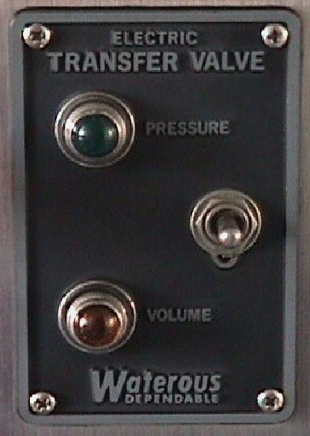
Two-Stage Centrifugal Pump
Change over Valve
Pressure mode limits the pump to half of its rated capacity.

Slide 19
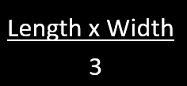
Fire Flow
National Fire Academy Formula
x Percent involved
Example: A 30’ x 50’ building that’s 25 percent involved, the fire flow would be 30 x 50 = 1,500 square feet, divided by 3 = 500 x 0.25 = 125 gpm.
Notes:
The NFA formula was developed as part of the Preparing for Incident Command (PIC) Commanding the Initial Response (CIR) courses (late 1980s) based on experienced fire officers opinions about the flow rate required for attack lines and backup lines for hypothetical fire scenarios. The NFA formula was intended for offensive operations. The flow rates estimated by these officers was divided by the area of involvement for each scenario with the resulting constant being 3.

Slide 20
Iowa Formula
Notes:
The Iowa Rate of Flow is based on work performed by Keith Royer and Bill Nelson while they were working for Iowa State University’s fire training program. While studying the effects of fog streams on interior fires, the pair demonstrated that all you need to do is put the right amount of water in the right place for the fire to go out—something that’s often overlooked by the modern fire service. This formula only gives you the formula for full involvement of the designated structure

Slide 21
Fire Flow Practice
80’
12’

Slide 22
Fire Flow Practice
120’
50’

Slide 23
Fire Flow Practice
60’
200’

Slide 24
Tender Delivery Rate
TDR = TC / SCT
TDR = Tender Delivery Rate
TC = Tank Capacity (GPM)
SCT = Shuttle Cycle Time ( Minutes)
If a 2,000 gallon tender has a shuttle cycle time of 10 minutes, the tender delivery
rate is then 2,000 divided by 10 minutes or the shuttle cycle time. The tender delivery
rate would then be 200 gpm. If you had a offensive fire attack requiring 450 gpm you would
need two additional tenders to maintain the proper fire flow.

Slide 25
Shuttle Cycle Time
OPT = Off-load Preparation Time
OT = Off-loading time
OBT = Off load Break-down time
TTE = Travel Time Empty
FPT = Fill preparation time
FT = Fill Time
FPT = Fill Breakdown Time
TTF = Travel time full

